Slide 1

IMAGE

Slide 2
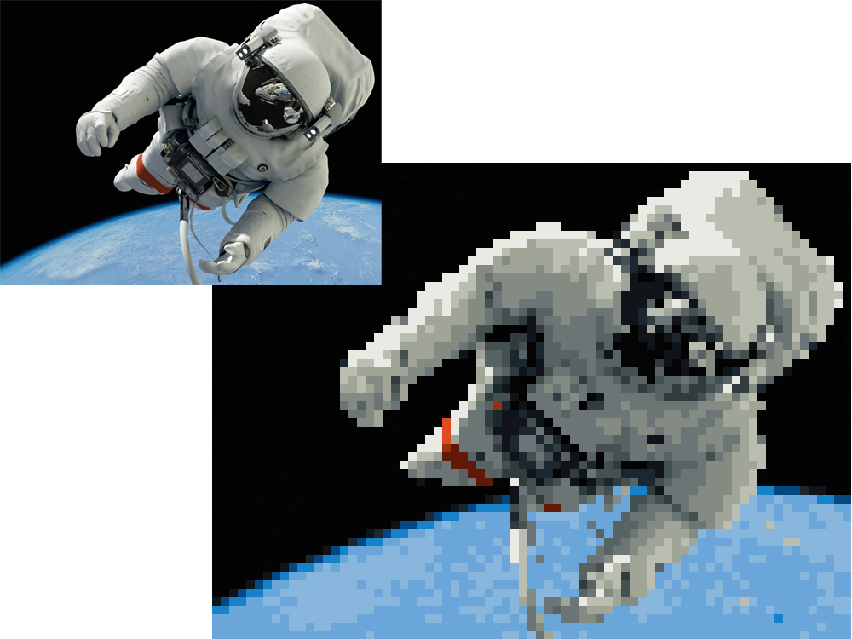
WHAT IS AN IMAGE?
Represented by rows and columns
Determined by Pixel values

Slide 3
TYPES OF IMAGES

Slide 4
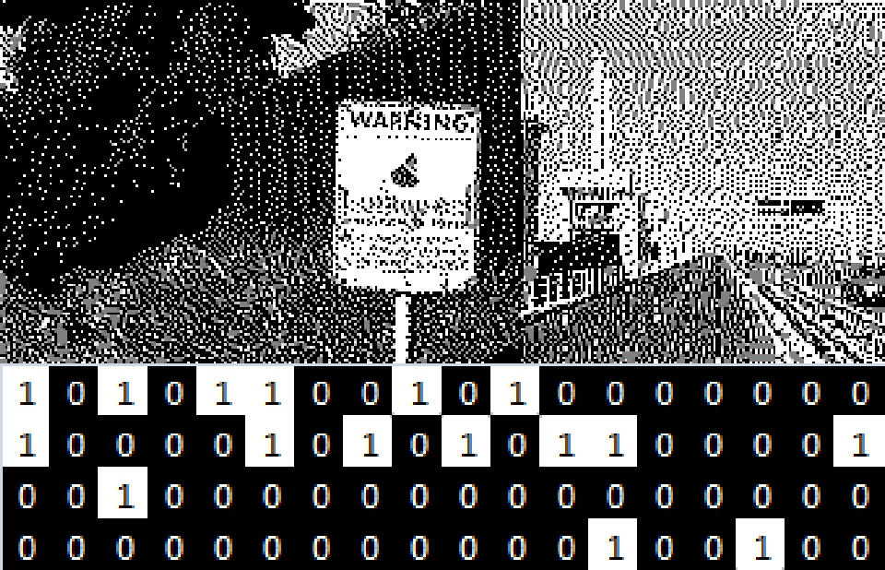
BINARY IMAGE

Slide 5

BLACK & WHITE IMAGE

Slide 6






8-bit
16-bit
24-bit
32-bit
1-bit
2-bit
3-bit
4-bit
6-bit
8-bit

Slide 7
8-BIT
00000000 → BLACK
00000001 → BLACK WITH LESS DARKNESS
00000010
…
…
…
11111111 → WHITE
OTHERS

Slide 8
CHANNELS FOR AN 8-BIT IMAGE
RED – 0 to 255
GREEN – 0 to 255
BLUE – 0 to 255
EG: YELLOW → Red = 255, Green = 255, Blue = 0

Slide 9
IMAGE FORMATS
.jpeg / .jpg
.png
.gif
.bmp
.eps
.tif / .tiff

Slide 10
APPLICATIONS OF IMAGE
Computer Vision
Artificial Intelligence
Computer Graphics, etc…

